Slide 1

Towards Comprehensive User Preference Learning:
Modeling User Preference Dynamics Across Networks for Recommendations
Dilruk Perera
Supervised by: A/P Roger Zimmermann
10/06/2020

Slide 2





Motivation: Recommender Systems
  Overwhelming amounts of information are available on today’s Web
  Information overload problem
Solution: Recommender Systems (RSs)
  Learn individual preferences from user profiles
  Automatically recommend interesting and unseen items to users
    500+ hours of videos uploaded per minute !
    270,000+ snapchat stories are created per minute !
User Profile
Recommendations

Slide 3
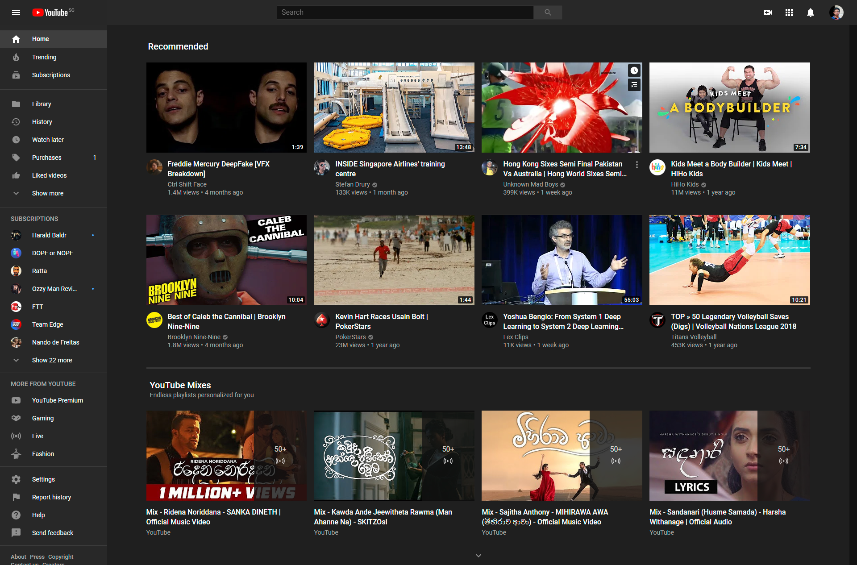
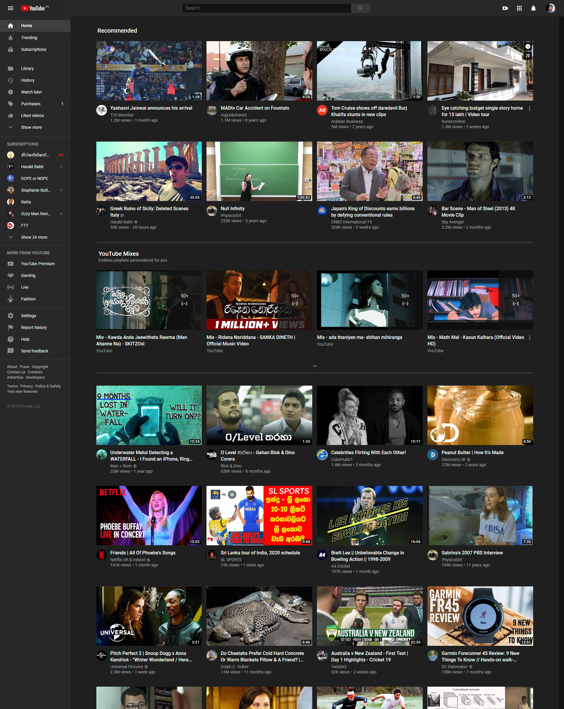


Motivation: Recommender Systems

Slide 4
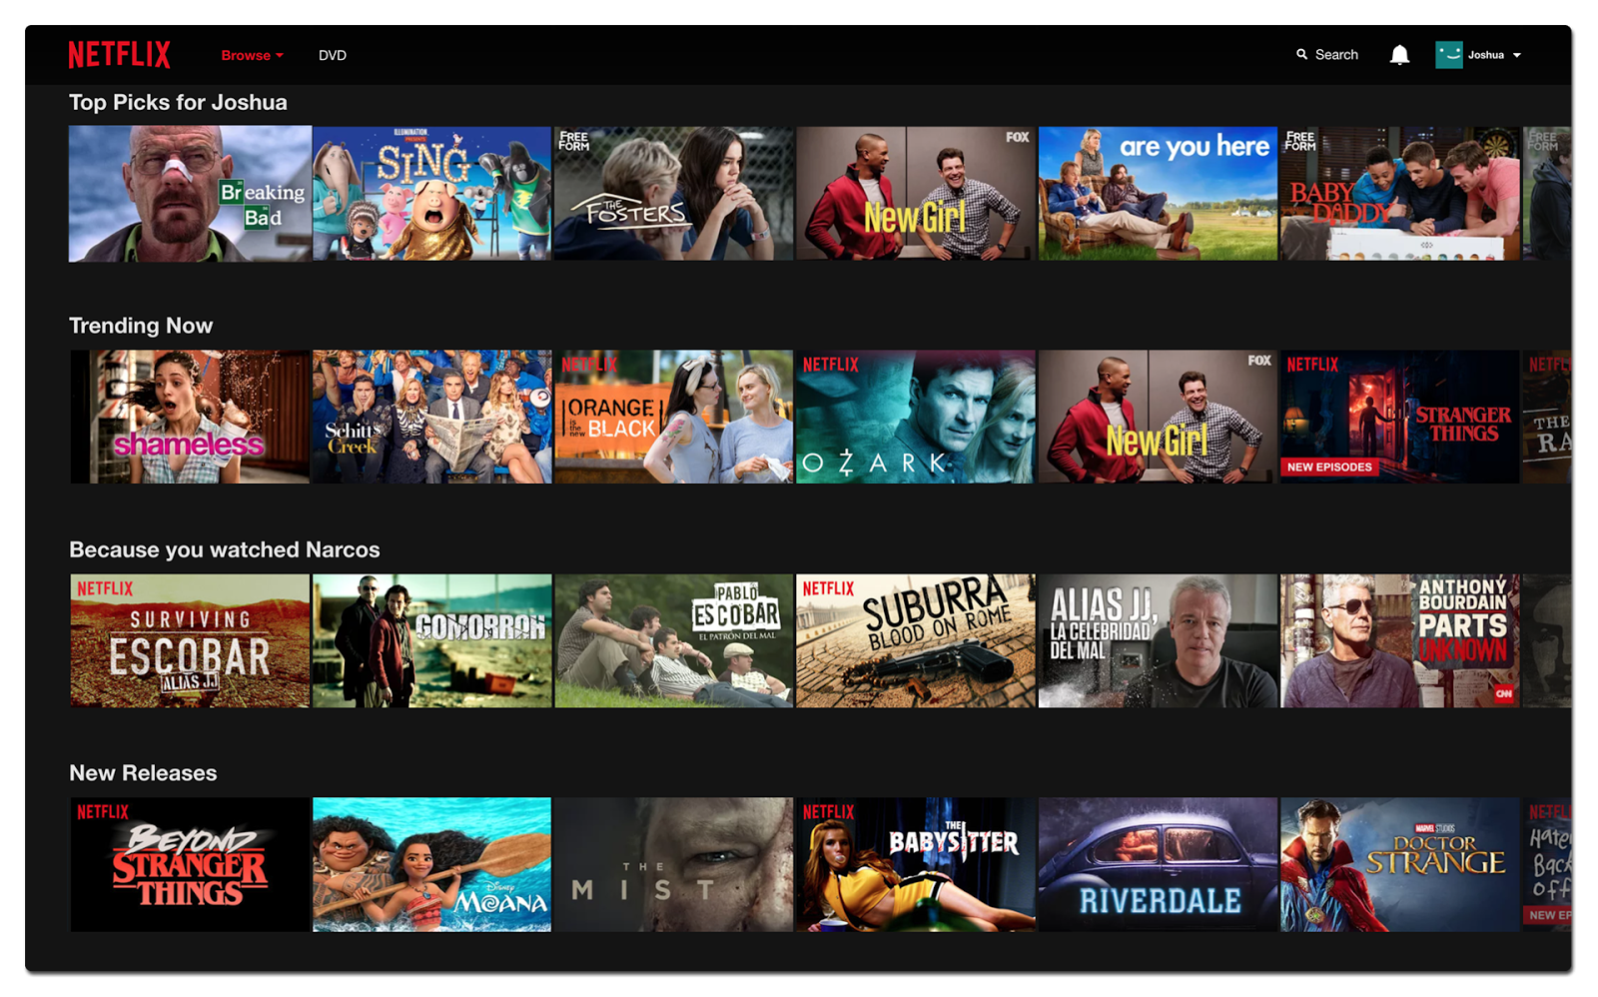

Motivation: Recommender Systems

Slide 5

Motivation: Recommender Systems
  Benefits for applications
75% of views are based on a recommendation
35% of sales are initiated by a recommendation

Slide 6
Motivation: Limitations of RSs
However, RSs continue to suffer from incomprehensive user preference learning
Two primary reasons:
  Incomplete user profiles
  Continuous changes in user preferences
Implication: Low overall recommendation quality

Slide 7




1) Incomplete User Profiles
New User
  No historical interactions with items
  Cannot comprehend their preferences
  Cold Start Problem
Existing User
  High item-user ratio causes sparse interactions
  High sparsity leads to low recommender accuracy
  Data Sparsity Problem
User Profile
…
User Profile
…

Slide 8



2) Continuous changes in user preferences
Reasons for user preference drifts
  User tastes/behavior changes
  Item popularity changes
  New items
  Etc.
Leads to recommender quality declining over time

Slide 9



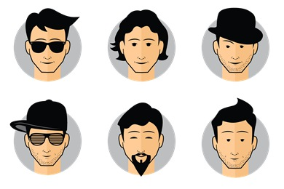



Solution
Both limitations co-exist in typical RSs
Need consolidated solutions to mitigate both these limitations simultaneously
  Incomplete user profiles
      Use cross-network user profile information
  Continuous changes in user preferences
      Incorporate temporal context information
      Explicitly model user preference dynamics
Approach: Integrate user preference dynamics across networks to comprehensively learn user preferences
Goal: Improve overall recommendation quality

Slide 10
Outline
1. Feasibility and Effectiveness
of modeling user preference dynamics across networks for comprehensive user preference learning
2. Practicality
3. Data Challenge

Slide 11


Dataset Statistics
Target network
Source networks
Overlapped users | 2,500+
YouTube videos | 13,500+
Tweets | ≈3,000,000
Dataset span | 2 years (2015–2017)

Slide 12

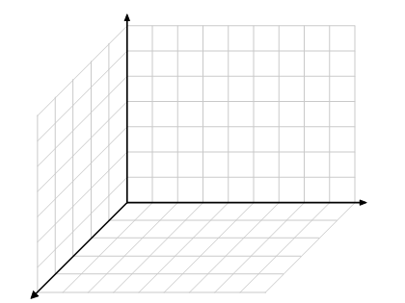


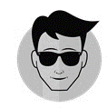




Feasibility and Effectiveness: Summary
First model-based solution to exploit and integrate user preference dynamics across networks
Extended the vanilla Matrix Factorization (MF) approach to incorporate time aware and cross-network information
Source network user interactions
$$f_{req}$$
$$f_{yt}$$
$$t_{1}$$
$$f_{yt}$$
$$…$$
$$…$$
$$t_{t}$$
$$f_{Tr1}$$
$$t_{n}$$
$$∑$$
$$f_{T}$$
$$f_{Tr2}$$
$$t_{n+1}$$
Topic Modeling
$$Time$$
$$T$$
$$T$$
$$t_{1}$$
Temporal prediction function
$$…$$
$$…$$
$$K$$
$$t_{t}$$
$$…$$
Transfer functions
$$K$$
$$t_{n}$$
$$Topics$$
$$t_{1}$$
$$t_{2}$$
$$t_{3}$$
$$t_{t}$$
$$t_{n}$$
Target network user interactions
Homogeneous Cross-network topical space
YouTube latent space
YouTube latent space
Dilruk Perera and Roger Zimmermann. “Exploring the use of Time-Dependent Cross-Network Information for Personalized Recommendations.” Proceedings of the 25th ACM International Conference on Multimedia (ACM MM), 2017

Slide 13
Feasibility and Effectiveness: Summary
First model-based solution to exploit and integrate user preference dynamics across networks
Extended the vanilla Matrix Factorization (MF) approach to incorporate time aware and cross-network information
Accuracy
Diversity
Novelty
New users
Existing users
Existing users

Slide 14
Outline
1. Feasibility and Effectiveness
2. Practicality
Handling the practical challenges
3. Data Challenge

Slide 15

LSTM Networks for Online Cross-Network Recommendations
Dilruk Perera, and Roger Zimmermann, “LSTM Networks for Online Cross-Network Recommendations,” International Joint Conference on Artificial Intelligence, (IJCAI), 2018

Slide 16

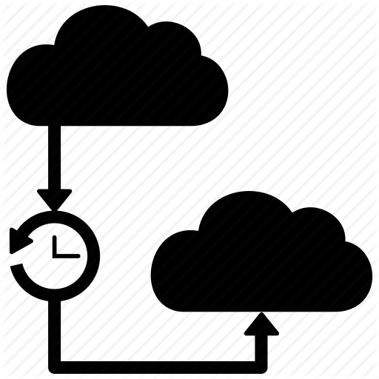

Motivation
A primary factor determining the practicality of large-scale RSs is latency
Majority of the proposed solutions are based on offline models
  Periodically retrained on renewed datasets to update recommendations
  Computationally expensive to retrain on growing datasets
    Retrain frequency (latency) depends on the complexity of the model
To avoid recommending the same set of items until the next update, trivial techniques are often used (e.g., removing already consumed items, recommending popular items )
  Less personalized
  Do not capture swift user preference drifts
  Leads to low quality recommendations

Slide 17
Solution
Considering the recommendation problem as a data stream problem, develop online recommender models
  Online Cross-network recommender model
  Continuously update the model using streams of incoming new user interactions from multiple networks
Goal: Provide timely recommendations with low latency

Slide 18
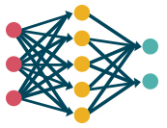

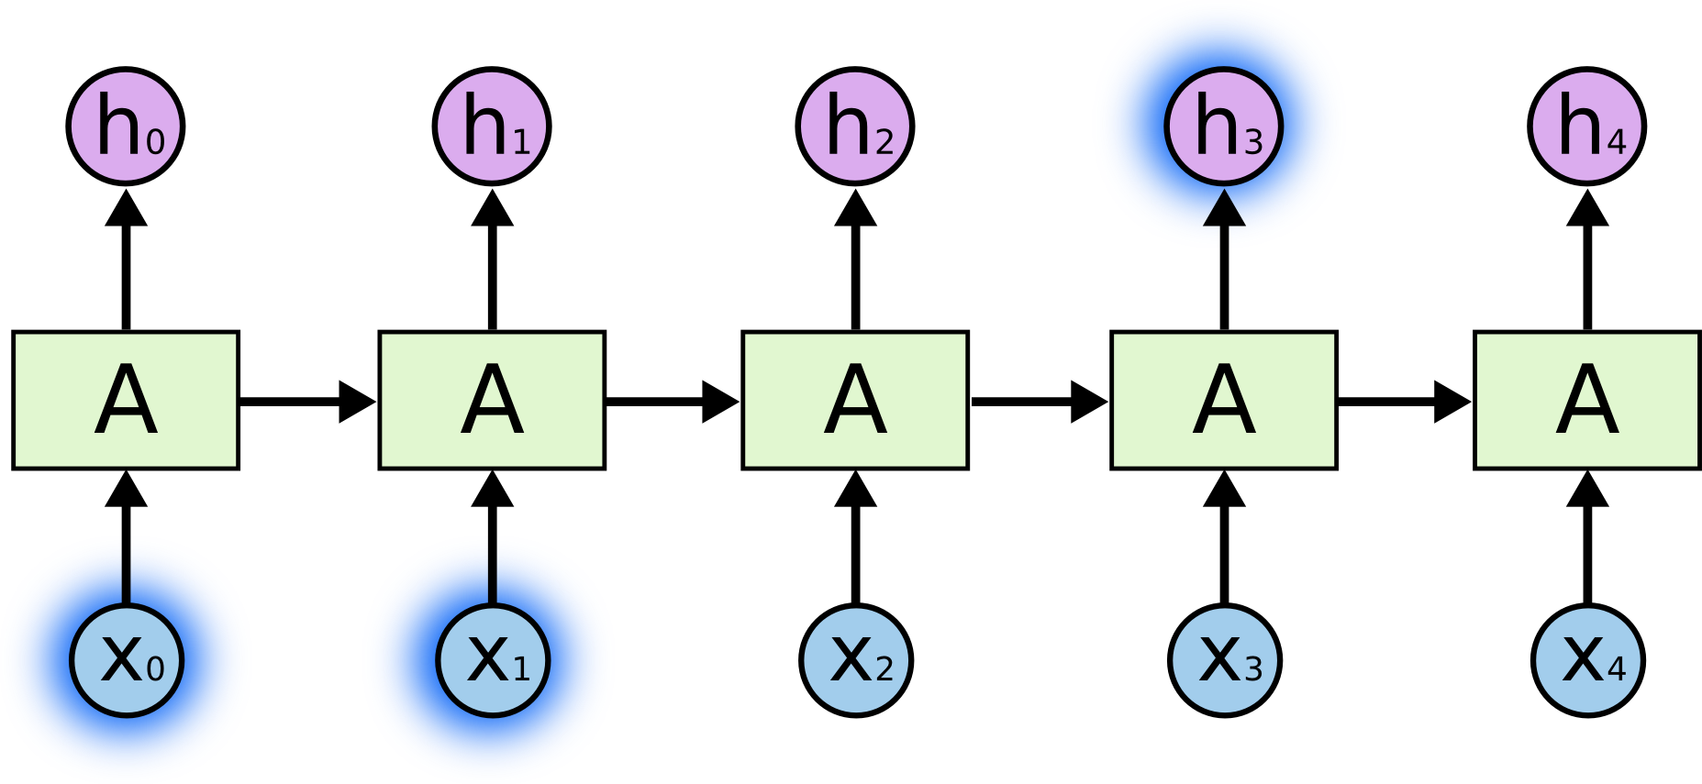
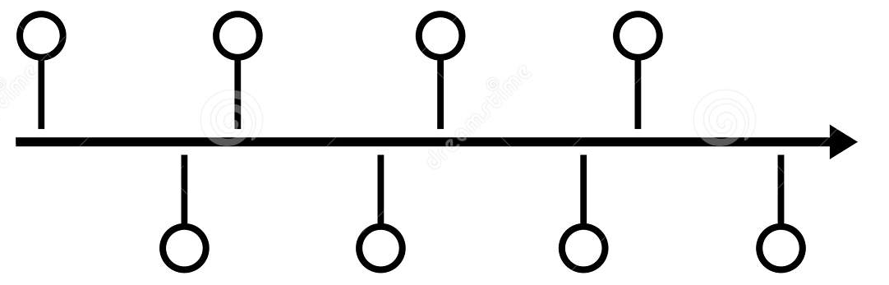







Model: LSTM
Neural architecture Naturally supports online learning
LSTM models cannot be directly used for the recommendation task
  Unable to handle highly sparse data
  Cell-state bottleneck
  Unable to handle irregular time gaps
$$Previous state$$
$$Forget$$
$$gate$$
$$Input$$
$$gate$$
$$Output$$
$$gate$$
$$Current state$$
$$Current inputs$$
  A higher-order interaction layer
  An attention mechanism
  Time aware gates

Slide 19










Process
Online Cross-network learning process
Interactions on source network $1$
Interactions on source network $2$
Interactions on target network
$$t−1$$
$$t$$
$$t+1$$
User preferences on the target network
$$∑$$
$$∑$$

Slide 20























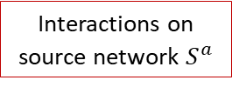







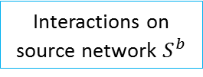













Overview: Online User Preference Update
1. Handles sparsity
3 Limitations of LSTM under the recommender setting
  1. Unable to handle highly sparse data
  2. Cell-state bottleneck
  3. Unable to handle irregular time gaps
Cross-network topical layer
Higher order interactions layer
Interactions on source network $S^{a}$
$$x_{1}^{a,t}$$
$$\left(x_{1}^{a,t}∙y_{1}^{a}\right)$$
$$e_{1}^{a,t}$$
$$x_{2}^{a,t}$$
$$⋯$$
$$Previous$$
$$1$$
$$0$$
$$4$$
$$preferences$$
$$⋯$$
$$x_{K^{t}}^{a,t}$$
$$e_{1}^{a,t}$$
$$\left(x_{K^{t}}^{a,t}∙y_{K^{t}}^{a}\right)$$
$$e_{K^{t}}^{a,t}$$
$$e_{K^{t}}^{a,t}$$
$$e_{1}^{a,t}. e_{K^{t}}^{a,t}$$
$$e_{K^{t}}^{a,t}.e^{i}$$
LSTM
cell
Input
$$…$$
$$Sum$$
$$0$$
$$1$$
$$e^{i}$$
$$i^{∆t}$$
$$⋯$$
$$0$$
$$t−1$$
$$t$$
$$u_{i}$$
$$e^{i}.e_{K^{t}}^{b,t}$$
$$Pooling$$
Highly sparse
$$e_{K^{t}}^{b,t}.e_{1}$$
$$Current$$
$$\left(x_{K^{t}}^{b,t}∙y_{K^{t}}^{b}\right)$$
$$e_{K^{t}}^{b,t}$$
$$e_{K^{t}}^{b,t}$$
$$preferences$$
$$x_{K^{t}}^{b,t}$$
$$⋯$$
$$e_{1}^{b,t}$$
Interactions on source network $S^{b}$
$$0$$
2. Handles cell state bottleneck
3. Supports irregular time intervals
$$1$$
$$⋯$$
$$2$$
$$x_{2}^{b,t}$$
$$x_{1}^{b,t}$$
$$\left(x_{1}^{b,t}∙y_{1}^{b}\right)$$
$$e_{1}^{b,t}$$

Slide 21

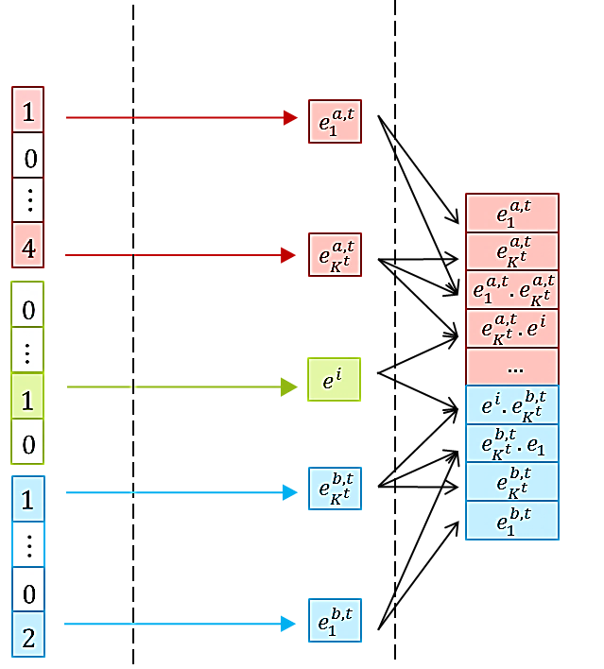
















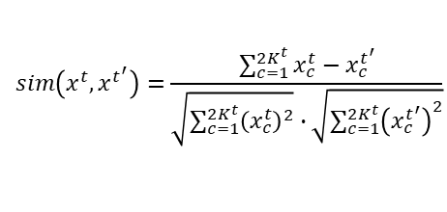




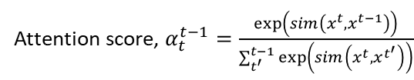





Solution: Cell State Bottleneck Issue
$$i_{A}^{t}=σ\left(W_{A}^{t}i^{∆t}+U_{A}^{t}h_{A}^{t−1}+b_{A}^{i}\right)$$
  Attention gates
    Reduces the burden of encoding the entire user history in the cell vector
    Allows the current cell state to refer back to previous states
$${\tilde{c}}_{A}^{t}=tanh\left(W_{A}^{c}i^{∆t}+U_{A}^{c}h_{A}^{t−1}+b_{A}^{c}\right)$$
$$C^{t}=C^{t−1}+{i_{A}^{t}⊙\tilde{c}}_{A}^{t}$$
Attention gates
$$C^{t−2}$$
$$C^{t−1}$$
$$C^{t}$$
LSTM cell
LSTM cell
LSTM cell
$$i_{A}^{t}$$
$${\tilde{c}}_{A}^{t}$$
$$…$$
$$σ$$
$$tanh$$
$$h^{t−2}$$
$$h^{t−1}$$
$$h^{t}$$
$$α_{t}^{t−2}$$
$$α_{t}^{t−1}$$
$$i^{∆t}$$
$$h_{A}^{t−1}$$
Weighted attention vector
$$h_{A}^{t−1}=\sum_{t^{′}}^{t−1}{α_{t}^{t−1}} ∙h^{t^{′}}$$
$$x^{t−2}$$
$$x^{t−1}$$
$$x^{t}$$
$$\left(t−2\right)$$
$$\left(t−1\right)$$
$$\left(current time, t\right)$$
Attention score, $α_{t}^{t−1}=\frac{\exp\left(sim\left(x^{t},x^{t−1}\right)\right)}{\sum_{t^{′}}^{t−1}{\exp\left(sim\left(x^{t},x^{t^{′}}\right)\right)}}$
$$sim\left(x^{t},x^{t^{′}}\right)=\frac{\sum_{c=1}^{2K^{t}}{x_{c}^{t}−x_{c}^{t^{′}}}}{\sqrt{\sum_{c=1}^{2K^{t}}{{\left(x_{c}^{t}\right)}^{2}}}∙\sqrt{\sum_{c=1}^{2K^{t}}{{\left(x_{c}^{t^{′}}\right)}^{2}}}}$$

Slide 22




















Solution: Irregular Time Gaps
  Incorporate irregular time gaps between interactions
  Conveys important information
    When time gap increases, previous cell state becomes less influential in determining current preferences (and vise versa)
$$\left(t−1\right)$$
$$\left(t\right)$$
  Two time aware gates:
Time aware gates
    $f^{t}$ : Time aware forget gate
$$C^{t−1}$$
$$C^{t}$$
    $i^{t}$ : Time aware input gate
LSTM cell
$$f^{t}$$
$$i^{t}$$
$$when ∆t$$
$${\tilde{c}}^{t}$$
$$σ$$
$$σ$$
$$tanh$$
$$h^{t}$$
$$f^{t}=e^{\left(−∆t\right)}∙σ\left(W^{f}i^{∆t}+U^{f}h^{t−1}+b^{f}\right)$$
$$h^{t−1}$$
$$i^{t}=\left(1−e^{\left(−∆t\right)}\right)∙σ\left(W^{i}i^{∆t}+U^{i}h^{t−1}+b^{i}\right)$$
$$∆t$$
$$i^{∆t}$$
$$C^{t}=f^{t}⊙C^{t−1}+i^{t}⊙{\tilde{c}}^{t}$$

Slide 23
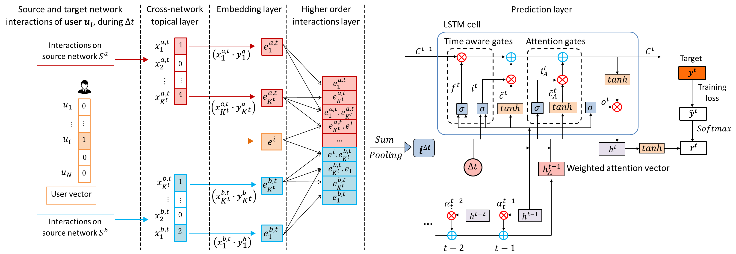
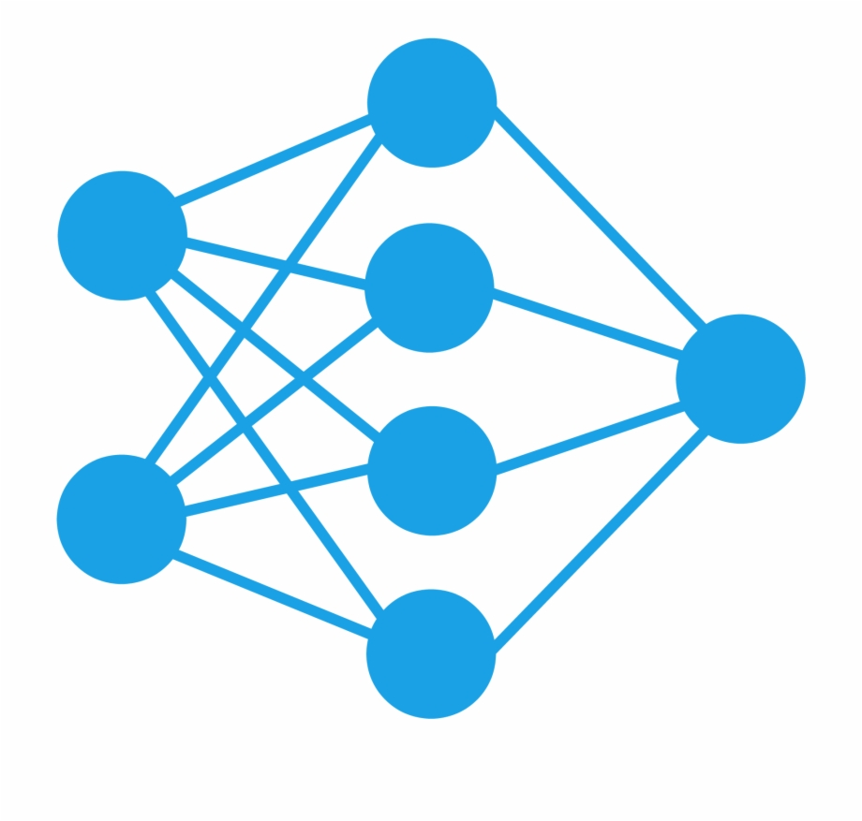
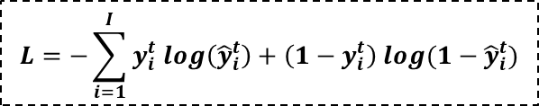


Prediction
  $r^{t}$ : Rating vector ($∈ℝ^{I}$)
0.06
0.02
0.02
…
0.04
0.02
  ${\hat{y}}^{t}$ : Normalized Ratings ($∈ℝ^{I}$)
  Cross-Entropy Loss:
  $$L=−\sum_{i=1}^{I}{y_{i}^{t} log\left({\hat{y}}_{i}^{t}\right)}+\left(1−y_{i}^{t}\right) log(1−{\hat{y}}_{i}^{t})$$

Slide 24
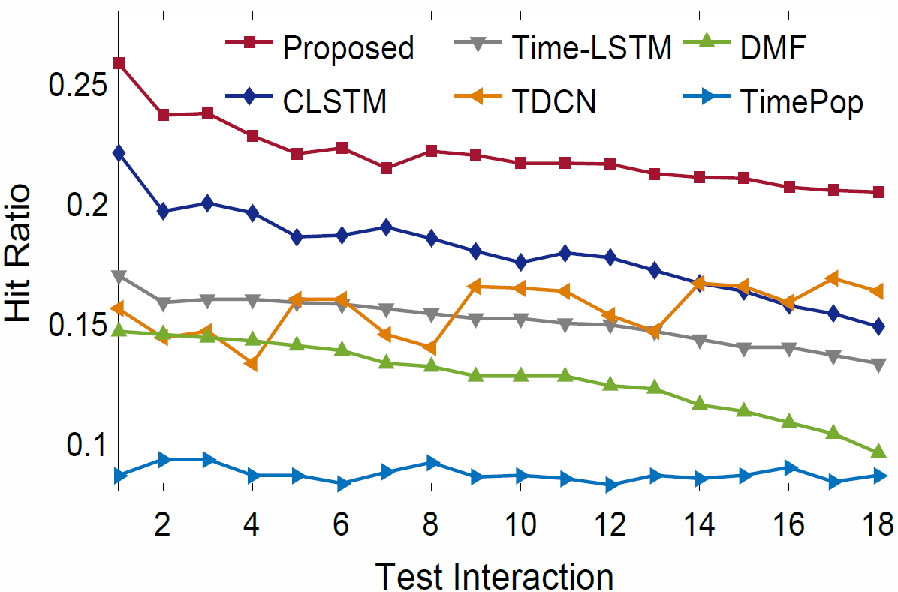
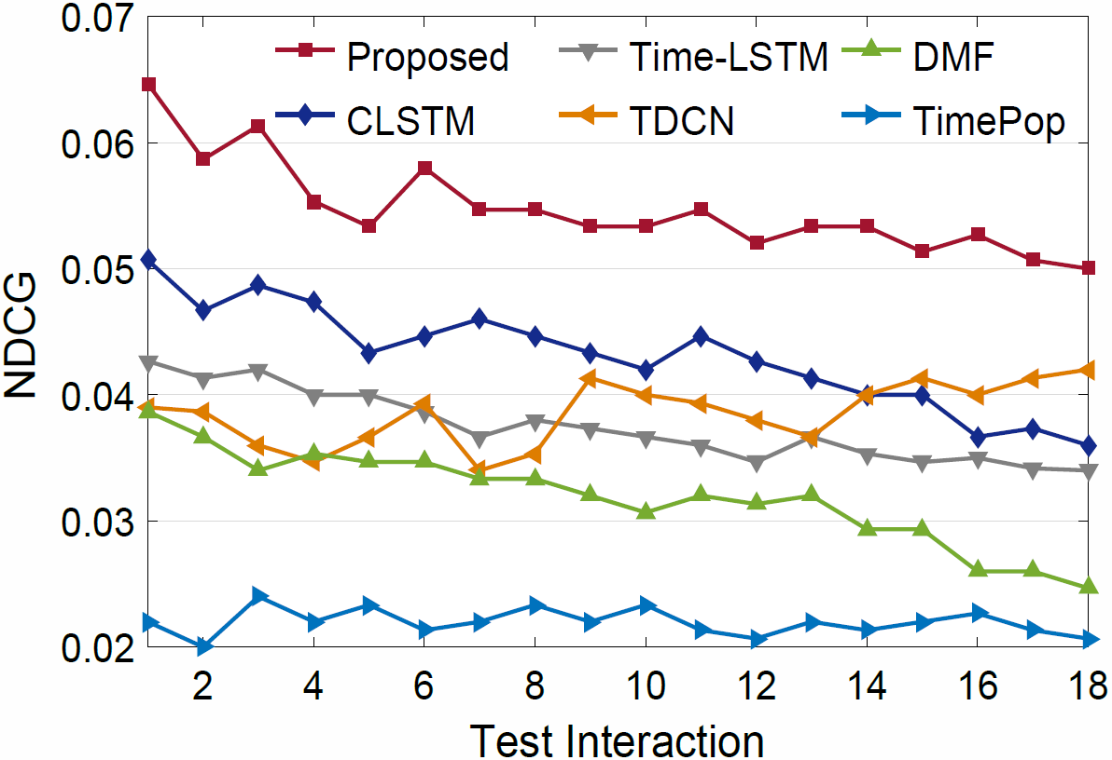
Results
  Accuracy
  Other metrics
  7.7% increase against the closest CLSTM
  12.8% increase against the closest CLSTM
  Low latency: Online training using few iterations (1-3)

Slide 25
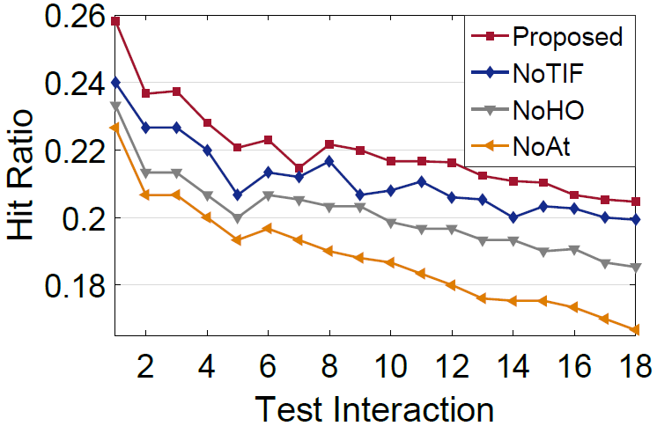
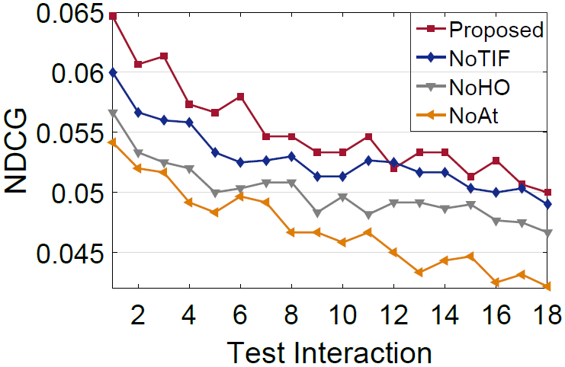
Results
  NoTIF : Time aware gates are omitted
  NoHO : Higher-order interaction layer is omitted
  NoAt : Attention gates are omitted
  Unable to handle irregular time gaps
  Unable to handle highly sparse data
  Cell-state bottleneck
  Time aware gates
  A higher-order interaction layer
  An attention mechanism

Slide 26
Outline
1. Feasibility and Effectiveness
2. Practicality
3. Data Challenge
- Handling the non-overlapped users whose interactions on other networks are unknown

Slide 27
Cross-network user preference generation for non-overlapped users
Dilruk Perera, and Roger Zimmermann, “CnGAN: Generative Adversarial Networks for Cross-network user preference generation for non-overlapped users,” The Web Conference, (WWW), 2019

Slide 28




Data Challenge
All good to replace single network recommender systems using cross-network systems?
  Existing cross-network solutions require users to be overlapped across networks
  Remaining non-overlapped users (majority) are ignored
Overlapped user
Non-overlapped user

Slide 29




Solution
Generative adversarial approach to synthetically generate missing user preferences data on source networks
Approach:
  Learn the mapping from target to source network preference manifolds using overlapped user interactions
Non-overlapped user

Slide 30




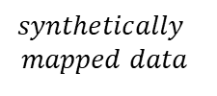
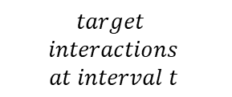




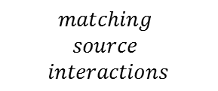




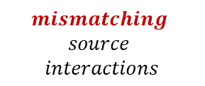
Adversarial Generation Process
$$mapping$$
$$unmapping$$
Adversarial training using 3 types of inputs:
$$Discriminator$$
$$matching$$
$data$
$$synthetically$$
$$mapped data$$
1. Matching data
$$mismatching$$
$data$
$$≪replicate≫$$
$$Generator$$
2. Synthetically mapped data
$${Enc}_{src}$$
$${Enc}_{src}$$
$${Enc}_{tgt}$$
3. Mismatching data
$$matching$$
$$source$$
$$interactions$$
$$target$$
$$interactions$$
$$at interval t$$
$$mismatching$$
$$source$$
$$interactions$$

Slide 31
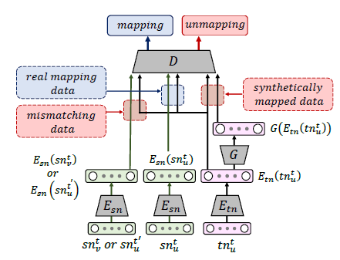
















Optimization: Generation Task
$Consists of 2 loss componenets$:
$$1. Discriminator \left(D\right) Loss:$$
$$\max_{E_{tn},{ E}_{sn}, D}{V(E_{tn},E_{sn},D)}$$
$$=L_{real}\left(E_{tn}\left({tn}_{u}\right),E_{sn}\left({sn}_{u}\right)\right)$$
$$+ L_{synthetic}\left(E_{tn}\left({tn}_{u}\right),G\left(E_{tn}\left({tn}_{u}\right)\right)\right)$$
$$+ L_{mismatch}\left(E_{tn}\left({tn}_{u}\right),E_{S}\left({\overline{sn}}_{u}\right)\right)$$
$$2. Generator \left(G\right) Loss:$$
$$\min_{G}{V(G)}$$
$$=L_{synthetic}\left(E_{tn}\left({tn}_{u}\right),G\left(E_{tn}\left({tn}_{u}\right)\right)\right)$$
$$+ L_{content}\left(E_{sn}\left({sn}_{u}\right),G\left(E_{tn}\left({tn}_{u}\right)\right)\right)$$
$$L_{real}\left(x,y\right)=\left[\log\left(D\left(x,y\right)\right)\right]$$
$$Overall Loss:$$
$$L_{synthetic}\left(x,y\right)=\left[1−\log\left(D\left(x,y\right)\right)\right]$$
$$\min_{G}{ }\max_{E_{tn},{ E}_{sn}, D}{V(E_{tn},E_{sn},G, D)}$$
$$L_{mismatch}\left(x,y\right)=\left[1−\log\left(D\left(x,y\right)\right)\right]$$
$$L_{content}\left(x,y\right)=\left\|x,y\right\|$$
$$D\left(x,y\right):Probability of Discriminator \left(D\right) identifying the given inputs as mapping inputs$$

Slide 32




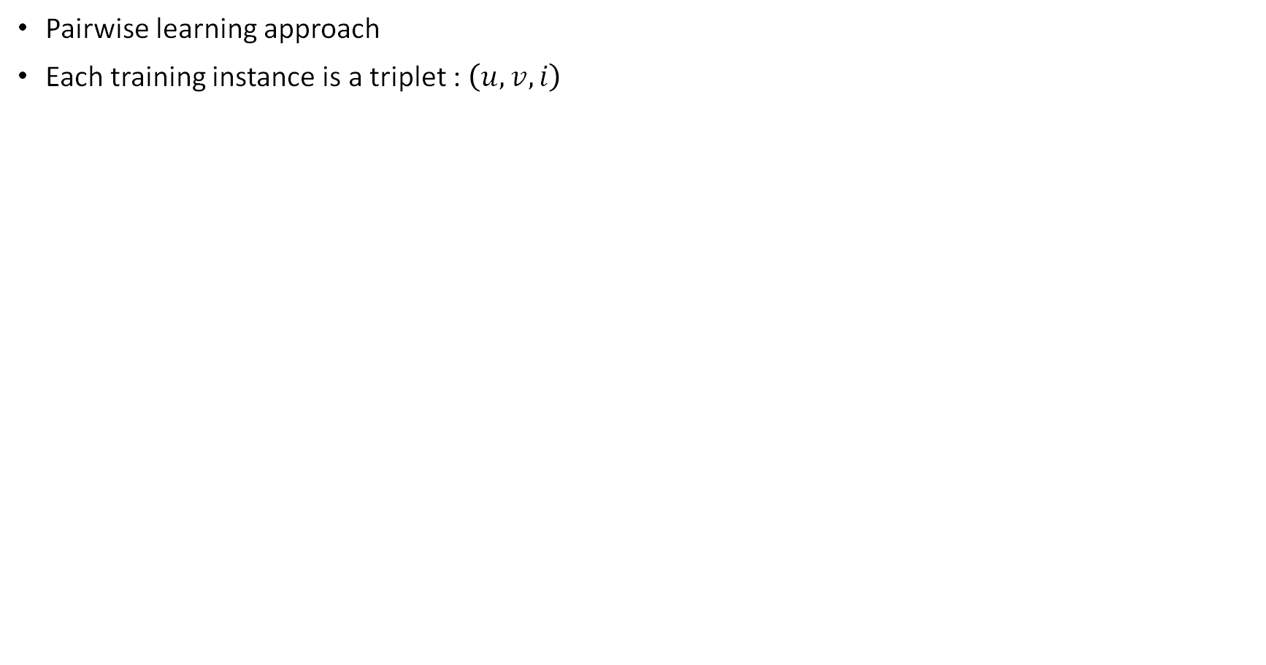







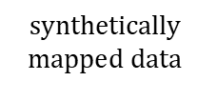




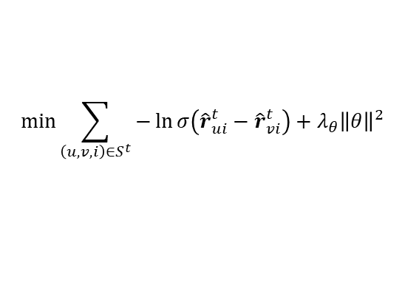



Recommendation Task
user $u$
user $v$
Pairwise learning approach
Each training instance is a triplet : $\left(u, v, i\right)$
item $i$
prediction
$${\hat{r}}_{ui}^{t}$$
$${\hat{r}}_{vi}^{t}$$
$$synthetically$$
$$mapped data$$
$$previous$$
$$interactions$$
$$user$$
$$preferences$$
Recommenda$tion \left(R\right) Loss:$
user $u$
$$\min_{ }{\sum_{\left(u, v, i\right)∈S^{t}}{−\ln{σ\left({\hat{r}}_{ui}^{t}−{\hat{r}}_{vi}^{t}\right)}+λ_{θ}{\left\|θ\right\|}^{2}}}$$
$$Neural Net$$
$${\hat{r}}_{ui}^{t}$$
$$G$$
0
…
$$item i$$
$${\hat{r}}_{ui}^{t}− {\hat{r}}_{vi}^{t}$$
1
…
0
$$maximize$$
user $v$
$${\hat{r}}_{vi}^{t}$$
$$Neural Net$$
$$G$$

Slide 33
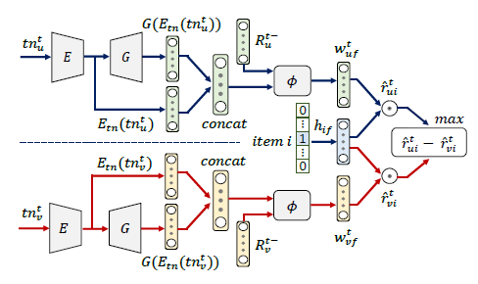

Multi-Task Learning approach
Both Generation and Recommender tasks depend on each other
  Generated user preferences are used for recommendations
  Recommendation errors are used to learn the Generator
Both tasks are learned as an end-to-end process in a multi-task learning environment
Generation
Recommendation

Slide 34
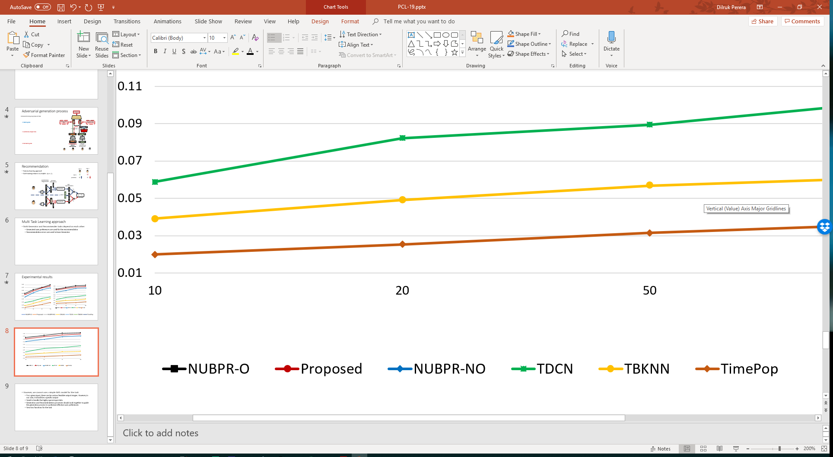
Experimental results
HR
NDCG
NUBPR-O : Fully overlapped data
Proposed : Synthetically generated data
NUBPR-NO : Target network data only

Slide 35
Summary
Approach: Integrating user preference dynamics across networks for comprehensive user preference learning
1. Feasibility and Effectiveness
2. Practicality
3. Data Challenge

Slide 36

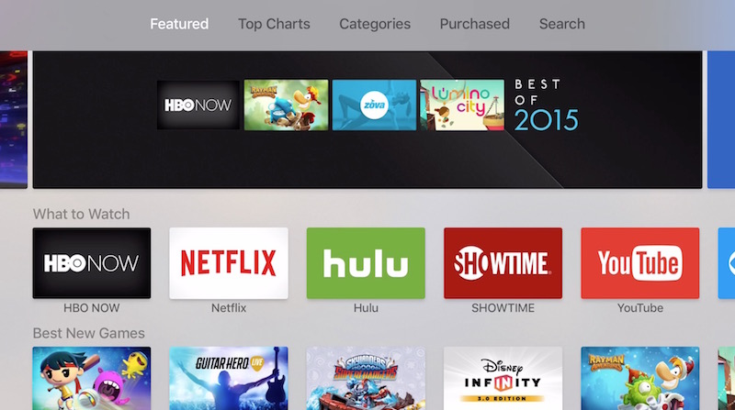
Develop one stop recommender platforms!!

Slide 37

Acknowledgements
Supervisor: Prof Roger Zimmermann
Thesis Committee: Prof David Rosenblum and Prof Min Yen Kan
Lab members of Multimedia Research
Friends in Singapore and back home
Family

Slide 38


Publications:
Dilruk Perera, and Roger Zimmermann. “Towards Comprehensive Recommender Systems: Time-Aware Unified Recommendations Based on Listwise Ranking of Implicit Cross-Network Data.” In Proceedings of the 34th AAAI Conference on Artificial Intelligence (AAAI), 2020
Dilruk Perera, and Roger Zimmermann, “CnGAN: Generative Adversarial Networks for Cross-network user preference generation for non-overlapped users,” The Web Conference, (WWW), 2019
Dilruk Perera, and Roger Zimmermann, “LSTM Networks for Online Cross-Network Recommendations,” 27th International Joint Conference on Artificial Intelligence, (IJCAI), 2018
Dilruk Perera and Roger Zimmermann, “Exploring the use of Time-Dependent Cross-Network Information for Personalized Recommendations,” 25th ACM International Conference on Multimedia, (ACM MM), 2017

Slide 39
Towards Comprehensive User Preference Learning:
Modeling User Preference Dynamics Across Networks for Recommendations
Dilruk Perera
Supervised by: A/P Roger Zimmermann

